Slide 1
Life Expectancy and Its Factors
Group 7:
Shachi Hardi - 75252019060
Vedant Wakankar – 75252019033
Sanjana Waghray- 75252019137
Malhar Khatu – 75252019118
Keisha Mehta -75252019051
Project Supervisor:
Dr. K. S. Madhava Rao.
Professor, Statistics at Sunandan Divatia School Of Science, NMIMS

Slide 2
Motivation
Life expectancy is the average number of years that a person is expected to live. It can be calculated for different ages (at birth, at the age of 65…) and it is carried out assuming that the mortality rates by age are being maintained ( which can also be called age-specific mortality pattern). It is a measure that summarizes the mortality of a country, allowing us to compare it by generations and analyze trends. Its interpretation and meaning is even richer and can provide us with key information on the level of development of a country’s welfare state. There is no better indicator of a country’s social development than having a long and healthy life. Therefore, the indicator’s importance is clear, as it provides us with many characteristics of society.

Slide 3
Project Objectives
To find out if there is a correlation between GDP of a country and its life expectancy. To test the hypothesis that the average life expectancy in 2015 is 69.3 .
To find the relation between life expectancy and population of countries around the world in 2015.
To find out if there is relation between Reported cases of measles per 1000 population and thinness % of population (10-19 years) in Asian countries in 2015.
To find the correlation between Adult Mortality and Alcohol Consumption.
To find out the correlation between percentage expenditure and under-five deaths in Asian countries for the year 2014.

Slide 4
Glossary
P value: - The probability that a particular statistical measure, such as the mean or standard deviation, of an assumed probability distribution will be greater than or equal to (or less than or equal to in some instances) observed results.
Correlation: - Correlation is a statistic that measures the degree to which two variables move in relation to each other.
Z test: - A z-test is a statistical test used to determine whether two population means are different when the variances are known, and the sample size is large.
Pearson’s Correlation Coefficient: - It is a measure of linear correlation between two sets of data. It is the ratio between the covariance of two variables and the product of their standard deviations.
Chi Square Test of Independence: - The Chi-square test of independence is a statistical hypothesis test used to determine whether two variables are likely to be related or not.
Hypothesis: - A research hypothesis is a specific, clear, and testable proposition or predictive statement about the possible outcome of a study.

Slide 5
Literature Review
Lelieveld, Pozzer, Haines et. al (2020): Have examined the loss of life expectancy from air pollution compared to other risk factors. Results state that ambient air pollution causes significant excess mortality and LLE. The loss of life expectancy rivals that of smoking tobacco.
Md. Nazrul Islam Mondal, Mahendran Shitan (2013) : Have examined the impact of demographic changes, socioeconomic inequalities and health factors on life expectancy on low and lower middle-income countries. Stepwise multiple regression has been used. Results state that necessity of more healthcare resources and higher levels of socioeconomic advantages are more likely to increase LE.
V Bilas, S Franc, M Bošnjak - Collegium antropologicum (2014): The main aim of this article is to explore determinants of life expectancy at birth among 28 European Union countries, in the period from 2001 to 2011 on a yearly basis by applying panel data analyses approach. Obtained results reveal that GDP per capita and attained education level together explain between 72.6% and 82.6% of differences in life expectancy at birth (depending on year of observation).

Slide 6
Data
Data has been collected from Kaggle using dataset published by Kumar Rajarshi, who has in turn collected the data from WHO and United Nations websites.
In this project we have considered data from year 2000-2015 for 193 countries for further analysis. The dataset consists of 22 Columns and 2938 rows which means 20 predicting variables.
Data cleaning has been carried out on Microsoft Excel, with all null values being removed from the dataset.

Slide 7
Description Of Data
Description of dataset:
There are 22 columns and 2938 rows of data.
Variables included in the dataset are:
Country:- Country
Year:- Year
Status:- Developing or Developed
Life Expectancy – Life Expectancy in Age
Adult mortality:- Adult Mortality Rates of both sexes (probability of dying between 15 and 60 years per 1000 population).
Adult mortality:- Adult Mortality Rates of both sexes (probability of dying between 15 and 60 years per 1000 population).
Infant deaths: - Number of Infant Deaths per 1000 population.
Alcohol: - Alcohol, recorded per capita (15+) consumption (in litres of pure alcohol
Percentage Expenditure: - Expenditure on health as a percentage of Gross Domestic Product per capita (%)

Slide 8
Description Of Data
Hepatitis B: - Hepatitis B (HepB) immunization coverage among 1: -year: -olds (%)
Measles: - Measles: - number of reported cases per 1000 population
BMI: - Average Body Mass Index of entire population
Under five deaths: - Number of under: -five deaths per 1000 population
Polio: - Polio (Pol3) immunization coverage among 1: -year: -olds (%)
Total Expenditure: - General government expenditure on health as a percentage of total government expenditure (%)
Diphtheria: - Diphtheria tetanus toxoid and pertussis (DTP3) immunization coverage among 1: -year:-olds (%)
HIV/AIDS: - Deaths per 1000 live births HIV/AIDS (0: -4 years)
GDP: - Gross Domestic Product per capita (in USD)
Population: - Population of the country
Thinness (10: -19): - Prevalence of thinness among children and adolescents for Age 10 to 19 (%)
Thinness (5: -9) – Prevalence of thinness among children for Age 5 to 9(%)
Income composition: - Human Development Index in terms of income composition of resources (index ranging from 0 to 1)
Schooling: - Number of years of Schooling (years)

Slide 9
Statistical Techniques
Exploratory Data analysis was first carried out on all data points of Life Expectancy, barring the missing values (which were deleted). The data analysis package in Microsoft Excel was used to find the summary statistics, and Microsoft Excel was again used to construct appropriate graphs
PEARSON’S CORRELATION COEFFICIENT:
Pearson’s Correlation Coefficient has been used to find out the degree and magnitude of correlation between the two variables. Pearson’s Correlation Coefficient is utilized when you have two quantitative variables and you wish to see if there is a linear relationship between those variables. Pearson’s Correlation Coefficient has been chosen over Spearman correlation as the data is measured on a ratio scale, not an ordinal scale.

Slide 10
Statistical Techniques
CHI-SQUARE TEST OF INDEPENDENCE:
Chi square test of independence is a statistical hypothesis test used to determine whether two categorical or normal variables are likely to be related or not. The purpose of this test is to determine if a difference between observed data and expected data is due to chance, or if it is due to a relationship between the variables under study. Chi-square test of Independence was used because of its robustness with respect to distribution of the data, ease of computation and its flexibility in handling data from both two group and multiple group studies.

Slide 11
Statistical Techniques
FISHER’S Z TRANSFORMATION TEST:
Prof. Ronald Fisher developed a technique for testing the significance of correlation coefficient in small samples. The Fisher Z-Transformation converts the skewed distribution of the sample correlation (r) into a distribution that is approximately normal.
The Fisher transformation (aka Fisher z-transformation) can be used to test hypotheses about the value of the population correlation coefficient ρ between variables X and Y.

Slide 12
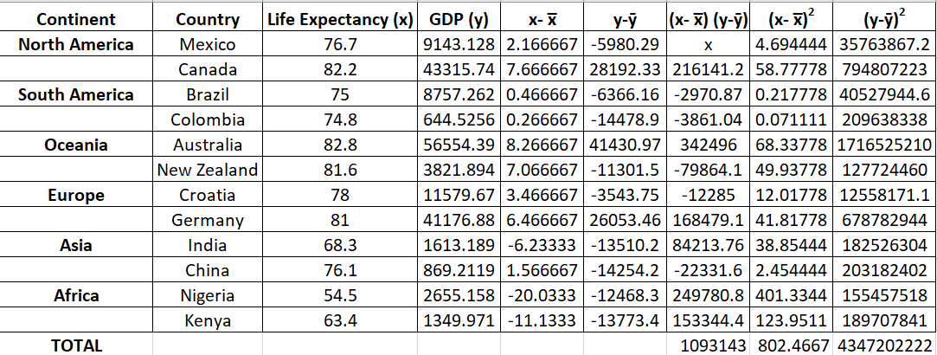
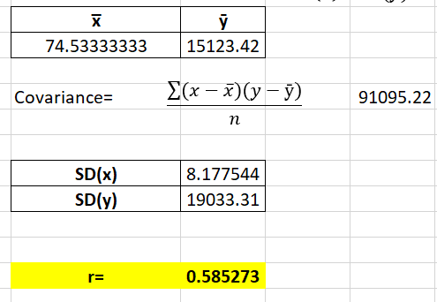

Analysis- Objective 1
To find out if there is a correlation between GDP of a country and its life expectancy.
$$r=\frac{covariance(x,y)}{SD\left(x\right)X SD(y)}$$
The value of r= 0.585273 indicates a moderate positive correlation between variables Life Expectancy and GDP.

Slide 13
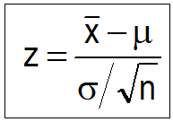
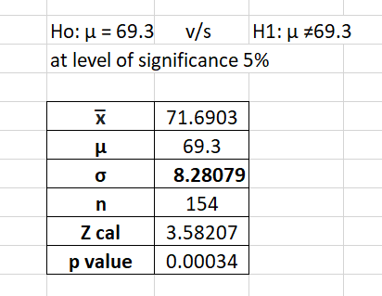
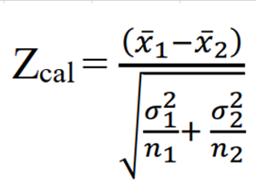
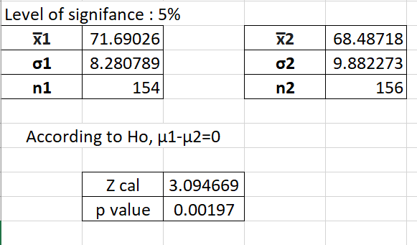
To test the hypothesis that the average life expectancy in 2015 is 69.3
Hence, as our p value < alpha (0.05) we have sufficient evidence to reject the null hypothesis.
To test for difference of means of Life Expectancy in years 2015 and 2005
As p value < α , reject Ho at 5% level of significance. There is significant statistical difference between the means of Life Expectancy in the year 2015 and 2005.

Slide 14
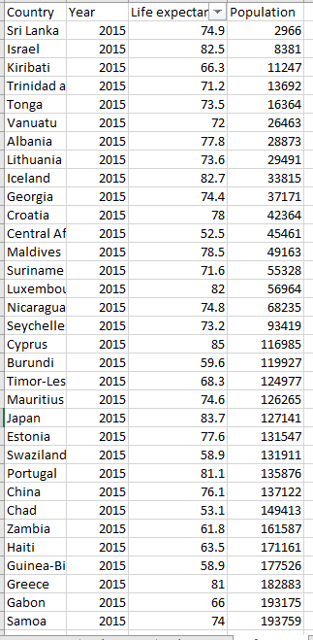
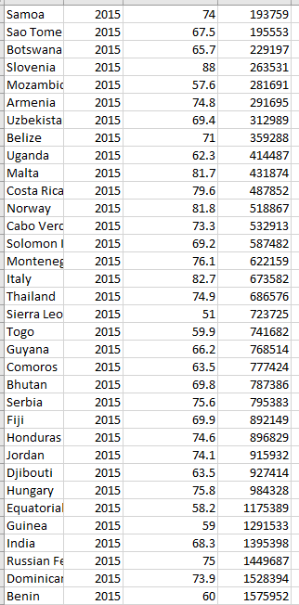
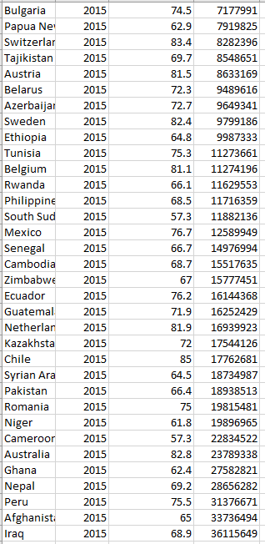
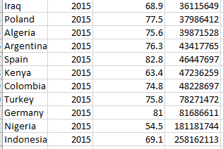
Analysis -Objective 2
To find the relation between life expectancy and population of countries around the world in 2015.
The following data was used for analysis

Slide 15
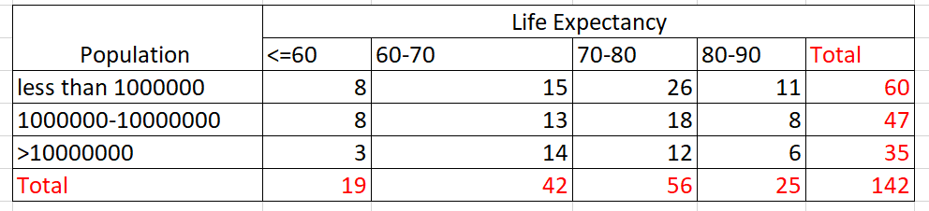
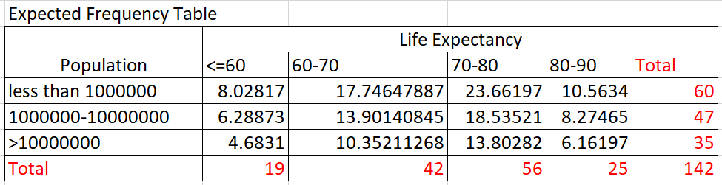
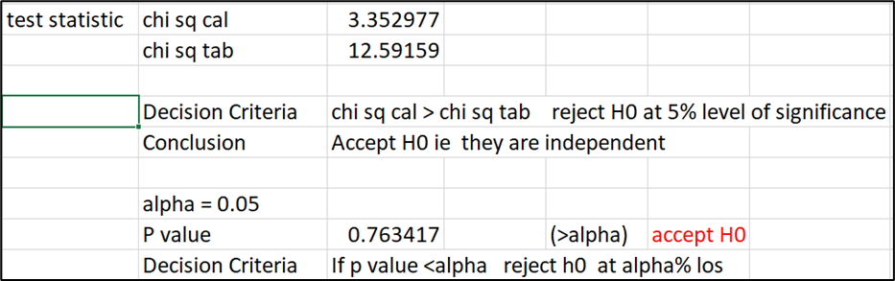
Hypothesis:
H0: Life expectancy and population of countries in 2015 are independent of each other
V/S
H1: Life expectancy and population of countries in 2015 are not independent of each other
Observed Frequency Table
Expected Frequency Table
Calculation of Chi-Square statistic is done as follows:
As we can see from the calculations,
Chi-square Cal < Chi-Square Tab also P value> alpha therefore we have sufficient evidence to not reject the null hypothesis.

Slide 16
Analysis – Objective 3
To find if there is relation between reported cases of measles per 1000 population and thinness % of population (10-19 years) in Asian countries in 2015.
The following data was used :
Country | Measles | Thinness 10-19 years
Afghanistan | 1154 | 17.2
Bangladesh | 240 | 17.9
Bhutan | 11 | 15.4
Brunei Darussalam | 4 | 5.7
China | 42361 | 3.6
India | 90387 | 26.7
Indonesia | 15099 | 1.4
Iran (Islamic Republic of) | 615 | 8.5
Iraq | 1433 | 5.3
Israel | 80 | 1.2
Japan | 35 | 2.1
Kazakhstan | 526 | 2.4
Kuwait | 18 | 3.5
Kyrgyzstan | 17779 | 3.3
Lao People's Democratic Republic | 56 | 8.8
Malaysia | 1318 | 7.5
Mongolia | 20359 | 2.2
Myanmar | 6 | 12.8
Nepal | 1599 | 15.7
Pakistan | 386 | 19.2
Philippines | 619 | 1
Qatar | 18 | 5.2
Republic of Korea | 7 | 1.5
Russian Federation | 843 | 2.3
Saudi Arabia | 219 | 7.8
Sri Lanka | 1568 | 15.1
Syrian Arab Republic | 45 | 6.3
Tajikistan | 3 | 3.6
Thailand | 154 | 7.7
Timor-Leste | 43 | 1.9
Turkey | 342 | 4.9
United Arab Emirates | 347 | 5.3
Uzbekistan | 22 | 3
Viet Nam | 256 | 14.2
Yemen | 468 | 13.6

Slide 17
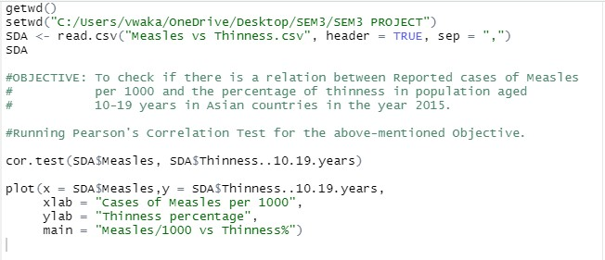
Test performed: Pearson’s correlation test ( R studio)
Hypothesis Testing:
Hypothesis: H₀: The variables are independent of each other. H₁: The variables are dependent on each other.
The following code has been used to get the desired output

Slide 18
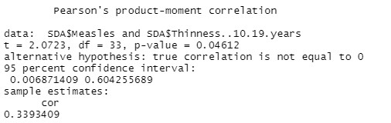
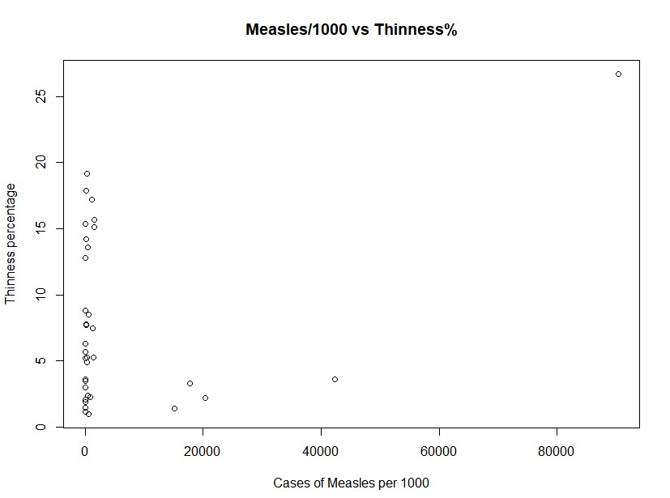
Output:
Plotting the code gives the following scatter plot.

Slide 19
Analysis – Objective 4
To find the correlation between Adult Mortality and Alcohol Consumption in the year 2014.
Dataset: Data pertaining to the above objective was filtered out from the parent dataset and was used for the mentioned tests.
Test Performed: (Using R Studio) 1. Pearson’s Correlation Test.
2. Fisher’s Z Transformation Test.

Slide 20
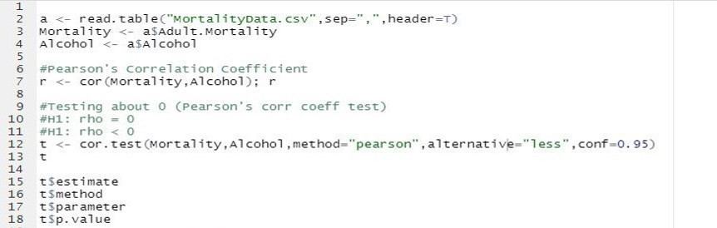
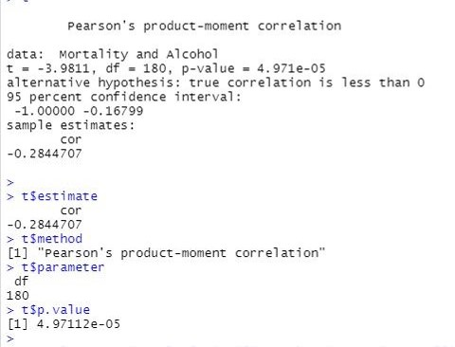
Hypothesis Testing: Pearson’s Correlation Test Hypothesis: H₀: rho = 0 v/s H₁: rho < 0
Output:
P-value < 5% (Level of significance), thus we have sufficient evidence to reject H0
Thus, Pearson's Correlation Coefficient is less than 0.
There is a weak negative correlation between Adult Mortality and Alcohol Consumption.

Slide 21
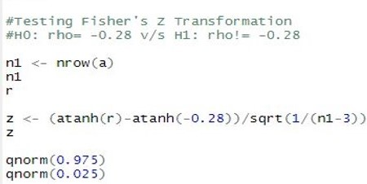
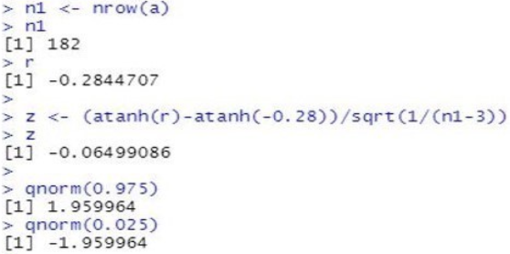
Hypothesis Testing: Fisher's Z Transformation Hypothesis: H0: rho = -0.28 v/s H1: rho != -0.28
Output:
Since z lies in Acceptance Region, we have insufficient evidence to reject H0.
Conclusion: Pearson's Correlation Coefficient = -0.28

Slide 22
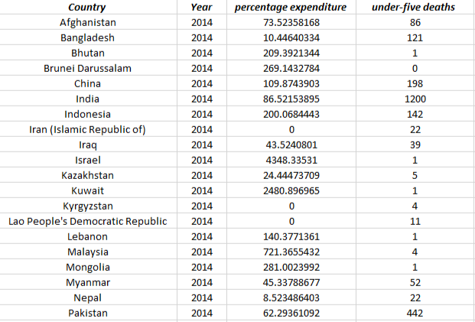
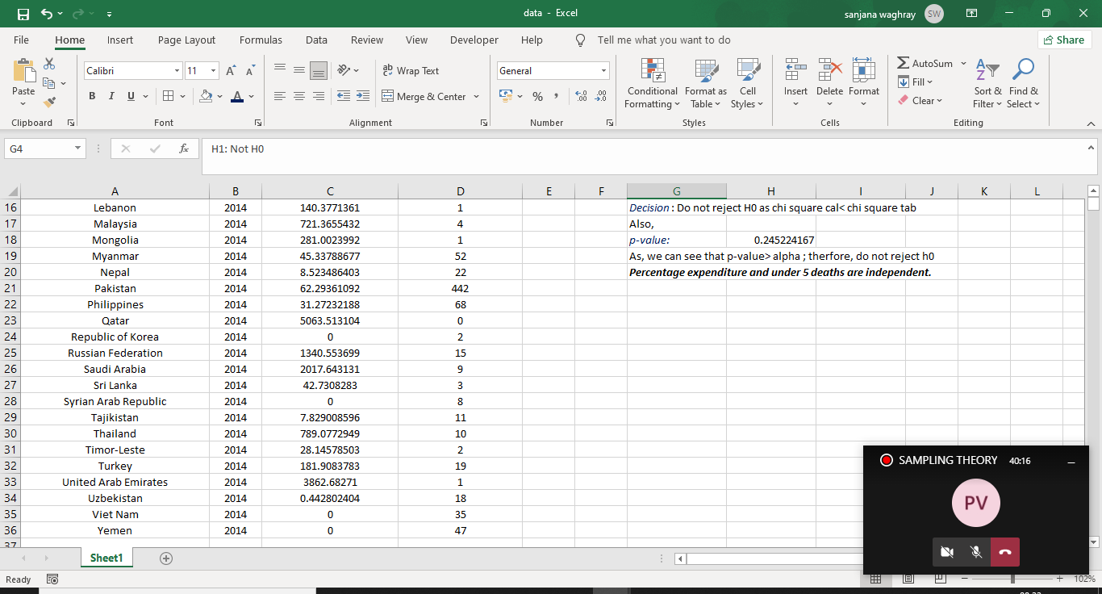
Analysis – Objective 5
To find out the correlation between percentage expenditure and under-five deaths in Asian countries for the year 2014. The following data was used:

Slide 23
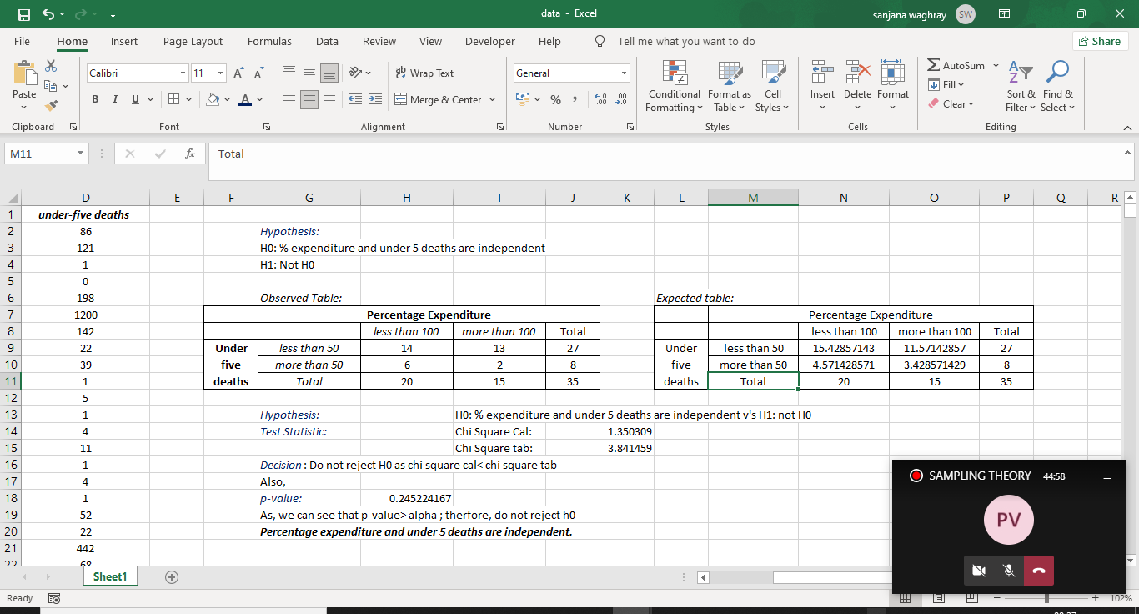
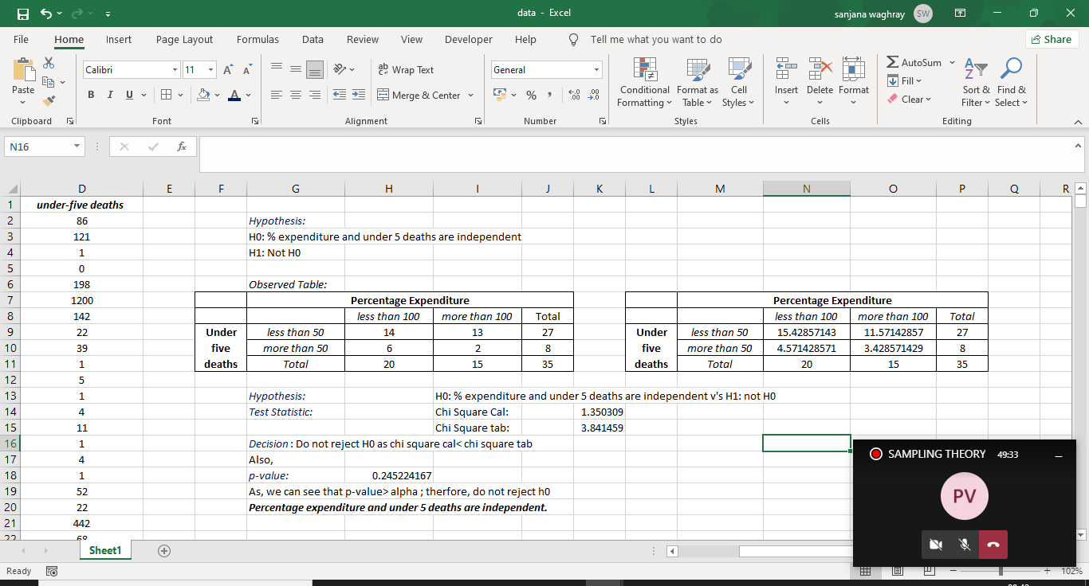
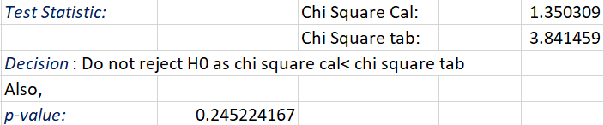
Test performed: Chi square test of Independence
Hypothesis:
H0: Percentage expenditure and under 5 deaths are independent of each other
v/s
H1: Percentage expenditure and under 5 deaths are not independent of each other
Observed Frequency:
Expected Frequency:
Calculation of test statistic:
As we can see from the given table that the value of chi square cal. < chi square tab. Therefore, with this we can conclude that we do not reject H0.

Slide 24
Conclusion
From objective 1 it can be concluded that GDP and Life Expectancy do depend on each other, in a moderate fashion. It can also be concluded that we do not have sufficient statistical evidence to say that the mean of Life Expectancy in the year 2015 is 69.3. Moreover, the values of average life expectancy has changed from the year 2005 to 2015, as there is significant statistical difference between them.
For Objective 2, the analysis performed using Chi-Square test of independence provides sufficient information to not reject the null hypothesis H0. Thus we can conclude that life expectancy and population of the countries around the world for the year 2015, are independent or not related to each other.
From Objective 3, our testing has resulted in the correlation value to be a considerable positive value and hence the data shows a positive association. Alternatively, p value is less than α and hence we reject the null hypothesis H0. Therefore, rejecting the null hypothesis we can conclude that the data shows positive association i.e. the variables are related.

Slide 25
Conclusion
From Objective 4, our testing has resulted in P-value < 5% (Level of significance), thus we have sufficient evidence to reject H0. To check for the value of the correlation, as per z test, since z lies in Acceptance Region, we have insufficient evidence to reject H0. Thus we can conclude that Pearson's Correlation Coefficient = -0.28. The correlation value is a considerably small negative value and hence the data shows a weak negative association between Adult Mortality and Alcohol Consumption.
From Objective 5, it can be concluded that we do not reject H0 as the value of chi square cal. is less compared to the value of chi square tab. Also, the p-value is greater than α which brings us to the conclusion that we do not reject H0 at 5% level of significance. Hence, percentage expenditure and under-five deaths are independent of each other.

Slide 26
Limitations
The tests performed above are few of the many available options. Various different methods of testing can give different conclusions.
The data collection method may not be as accurate as required (as the population size of each country is large). This accuracy directly influences the conclusions.
Correlation measures association, but doesn't show if x causes y or vice versa—or if the association is caused by a third factor.

Slide 27
THANK YOU

